Slide 1
Communication Management

Slide 2
Contents
Introduction
Communication management processes
Inputs, Tools & techniques and Outputs
Wrap up

Slide 3
Communication Management
Communication Management includes the processes required to generate, collect, disseminate, store and ultimately dispose project information.
Involves all the stake holders of the project
It is NOT “Communication Skills” as we generally perceive

Slide 4
Why do we need Communication Management?

Slide 5
Communication Management Processes
Communications Planning
Determining the information and communications needs of the stakeholders; Who needs what information, When they will need it and how it should be given
Information Distribution
Making needed information available to project stakeholders in a timely manner
Performance Reporting
Collecting and disseminating performance information, including status reports, progress measurement and forecasting
Administrative Closure
Generating, gathering and disseminating information to formalize a phase or project completion

Slide 6
Communications Management
Each of the processes occur at least once in a project
They interact with each other and with the processes in other knowledge areas as well

Slide 7
Communications Planning
Inputs
Communications Requirements
Communications Technology
Constraints
Assumptions
Tools and Techniques
Stakeholder Analysis
Outputs
Communications Management Plan

Slide 8
Communications Planning
Overview
Proactively determining the information needs of the stake holders
Who needs the information, when and in What form?
Organizational structure will have a major say
Communication Media include face-to-face, e-mail, meetings, telephone, fax etc
The PM spends about 90% of the time communicating
Care should be taken to avoid wasting resources on unnecessary information or inappropriate technology

Slide 9
Communications Management Plan
Output of Communications Planning
Includes
What information needs to be collected and when
Who will receive the information
Methods used to gather and store information
Limits, if any, on who may give direction and to whom
Reporting Relationships
List of contact information of all stakeholders
Schedule for distribution of information

Slide 10
Exercise
What information needs to be distributed on a project?

Slide 11
Information Distribution
Inputs
Work Results
Communications Management Plan
Project Plan
Tools & Techniques
Communication skills
Information Retrieval systems (e-cockpit?)
Information distribution methods
Outputs
Project records
Project outputs
Project Presentations

Slide 12
Communication Channels
Communications grow at non-linear rate
If there are N people, then there are N(N-1)/2 communication channels possible
Communications need to be managed but cannot be controlled

Slide 13
Performance Reporting
Inputs
Project Plan
Work Results
Other Project Records
Tools & Techniques
Performance Reviews
Variance, Trend, Earned Value Analysis
Information distribution tools and techniques
Outputs
Performance Reports
Change Requests

Slide 14
Exercise
Create a sample report for your project giving the status, progress and trends.
Include a distribution list

Slide 15
Administrative Closure
Inputs
Performance Measurement documentation
Product documentation
Other Project records
Tools & Techniques
Performance reporting tools and techniques
Project reports
Project Presentations
Outputs
Project Archives
Project Closure
Lessons Learned

Slide 16
Administrative Closure
Collecting Records
Updating Records
Archiving Records
Documenting all correspondence
Lessons Learned
Formal Acceptance
Product Verification
Performance Reporting

Slide 17
Communication Model
Communication has three parts; Sender, Receiver and the Message
The message is decoded by the receiver based on the receiver’s education, experience, language and culture.
Acknowledging the message (“Message understood”) helps.
About 55% of communication is Non-Verbal
Feedback is essential to reduce communication barrier (“Do you understand what I have explained?”)

Slide 18
Communication Methods
Complex Problems, Project Plans, Project Charter, Communicating over long distances | Memos, e-mail, Notes
Presentations, Speeches | Meetings, Conversations, Teleconferences
Written
Verbal
Formal
Informal

Slide 19
Communication Blockers
Noise
Distance
Improper en-coding of messages
Saying “that is a bad idea”
Hostility
Language
Culture

Slide 20
Performance Reporting
Status Report – Where the project now stands
Progress Report – What has been accomplished
Trend Report – Examining project results over time to see if performance is improving or deteriorating
Forecasting – Predicting future project status
Variance Report
Earned Value Report

Slide 21
Rules for Meetings
Set a time limit and keep to it
Schedule recurring meetings in advance
Meeting with team regularly, but not too often
Have a purpose for the meeting
Create an Agenda with team input
Distribute Agenda beforehand
Stick to the Agenda
Let people know in advance their responsibilities
Bring the right people together
Chair and lead the meeting with a set of rules
Assign deliverables and time limits for all tasks that result
Document and Publish minutes

Slide 22
Earned Value Management
Actual Cost of Work Performed (AC)
What is the actual cost incurred?
Budgeted Cost of Work Performed (BCWP) or Earned Value (EV)
What is the estimated value of the work actually accomplished?
Budgeted Cost of Work Scheduled (BCWS) or Planned Value (PV)
What is the estimated value of the work planned to be done?
Budget at Completion (BAC)
How much did you BUDGET for the total Job?
Estimate at Complete (EAC)
What do we currently expect the TOTAL project to cost?
Estimate to Complete (ETC)
From now on, how much MORE do we expect it to cost to finish the project?
Variance at Completion
How much over or under budget do we expect it to be?

Slide 23
Earned Value Management .. Formulae
Cost Variance (CV) = EV – AC
Negative is over budget and +ve is under budget
Schedule Variance (SV) = EV – PV
+ve is ahead of schedule and –ve is behind schedule
Cost Performance Index (CPI) = EV/AC
Schedule Performance Index (SPI) = EV/PV
Estimate At Complete (EAC) = BAC/CPI
Estimate To Complete (ETC) = EAC – AC
Variance At Completion (VAC) = BAC - EAC

Slide 24
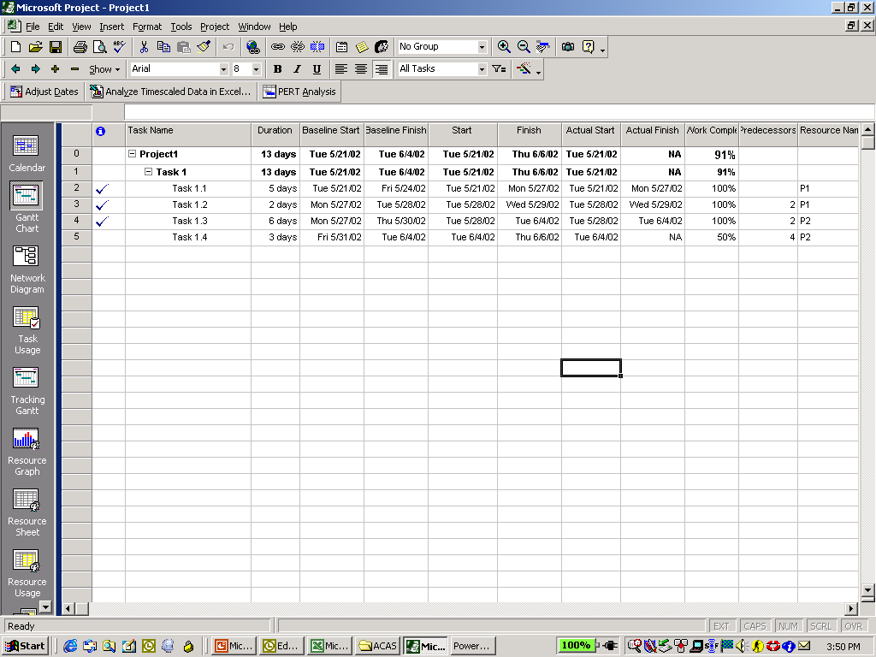
Earned Value and Microsoft Project

Slide 25
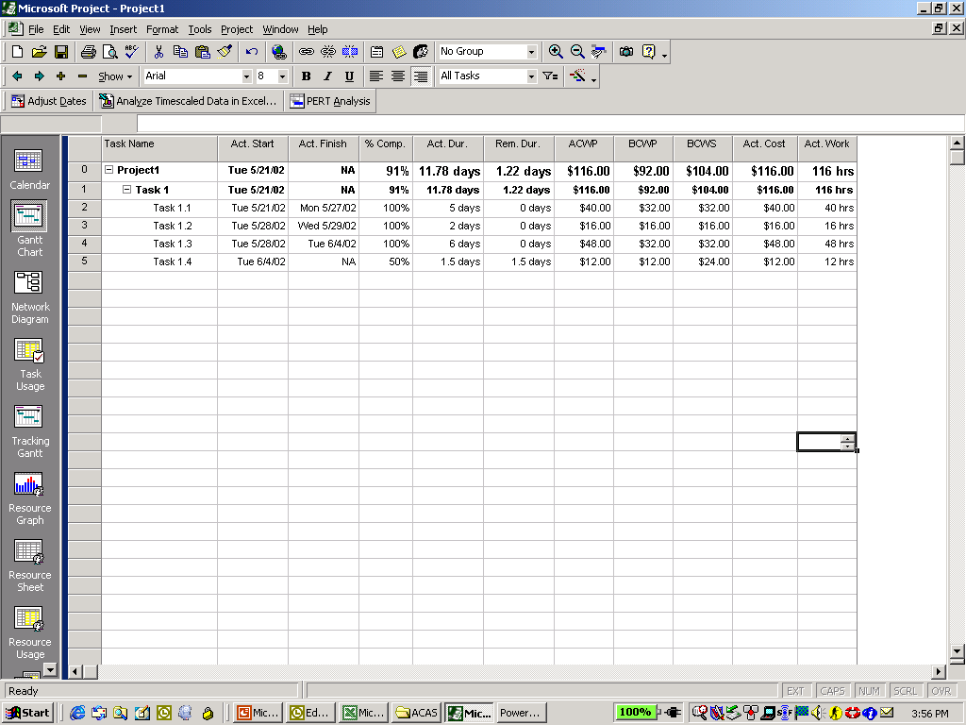
Earned Value in MS-Project

Slide 26
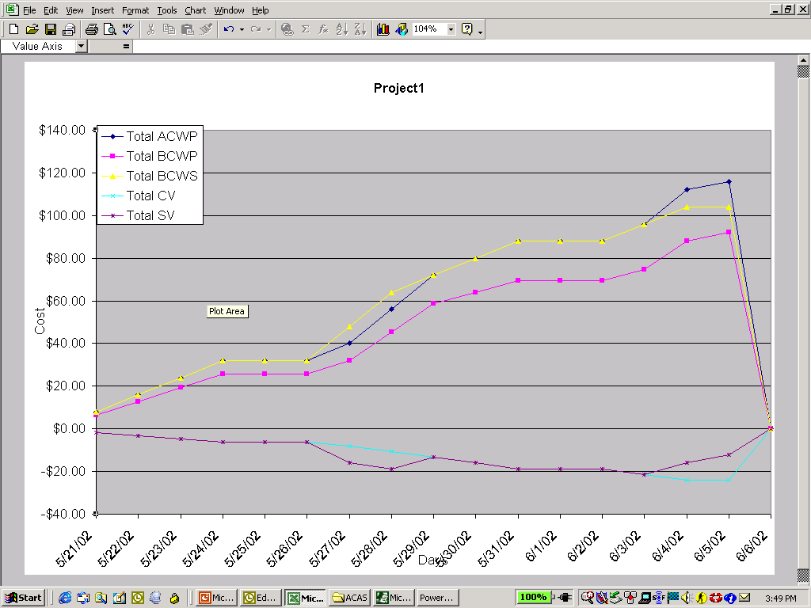
Earned Value Graphs using MS-Project

Slide 27
Exit Quiz
Please answer the questions in the Quiz and submit the sheet in 30 minutes.

Slide 28
Thank you !!!

